Slide 1



SafeLabel AI — Food Label Allergen Detection
Keywords: Artificial Intelligence · OCR · NLP · Named Entity Recognition · Allergen Detection · Ingredient Recognition · Multilingual Translation · Barcode Scanning · Personalized Allergy Profiles
Institution
Course
Superior University — Department of Computer Science, FCS&IT
Bachelor of Science in Computer Science — Final Year Project
Group
Supervisor
BSCS-1 — Student names & SAP IDs: not verifiable in project file (left blank)
Not verifiable in uploaded materials — left blank to avoid inventing details
Template conformity: names, IDs and supervisor were not readable in the project file and are intentionally omitted per instructions.

Slide 2
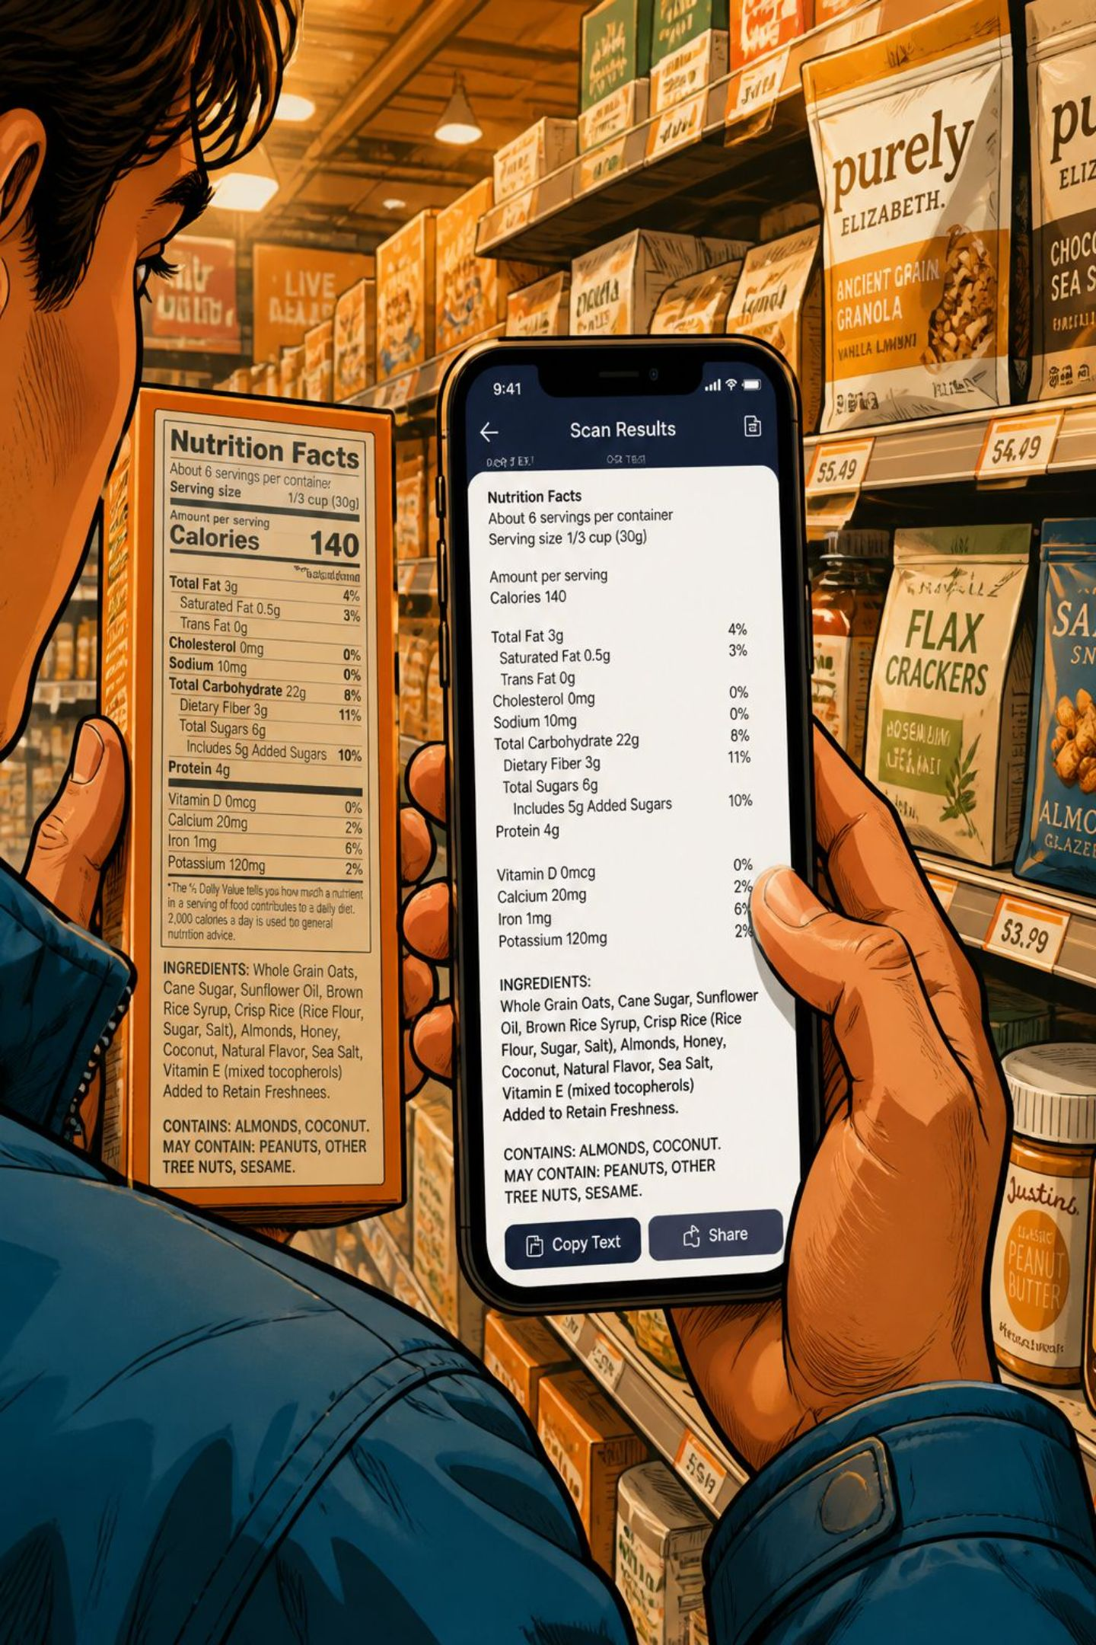
Introduction
SafeLabel AI helps users identify potential allergens on packaged foods when labels are unfamiliar or in another language. Within seconds the app converts camera input or barcode scans into structured ingredient data, highlights possible allergens relative to a user profile, and explains uncertain matches.
01
15‑second hook
"What if you are allergic to peanuts but the label is unreadable? SafeLabel AI scans and interprets labels for you."
02
Primary goal
Reduce the time and cognitive load required to check ingredient labels across languages and formats.

Slide 3
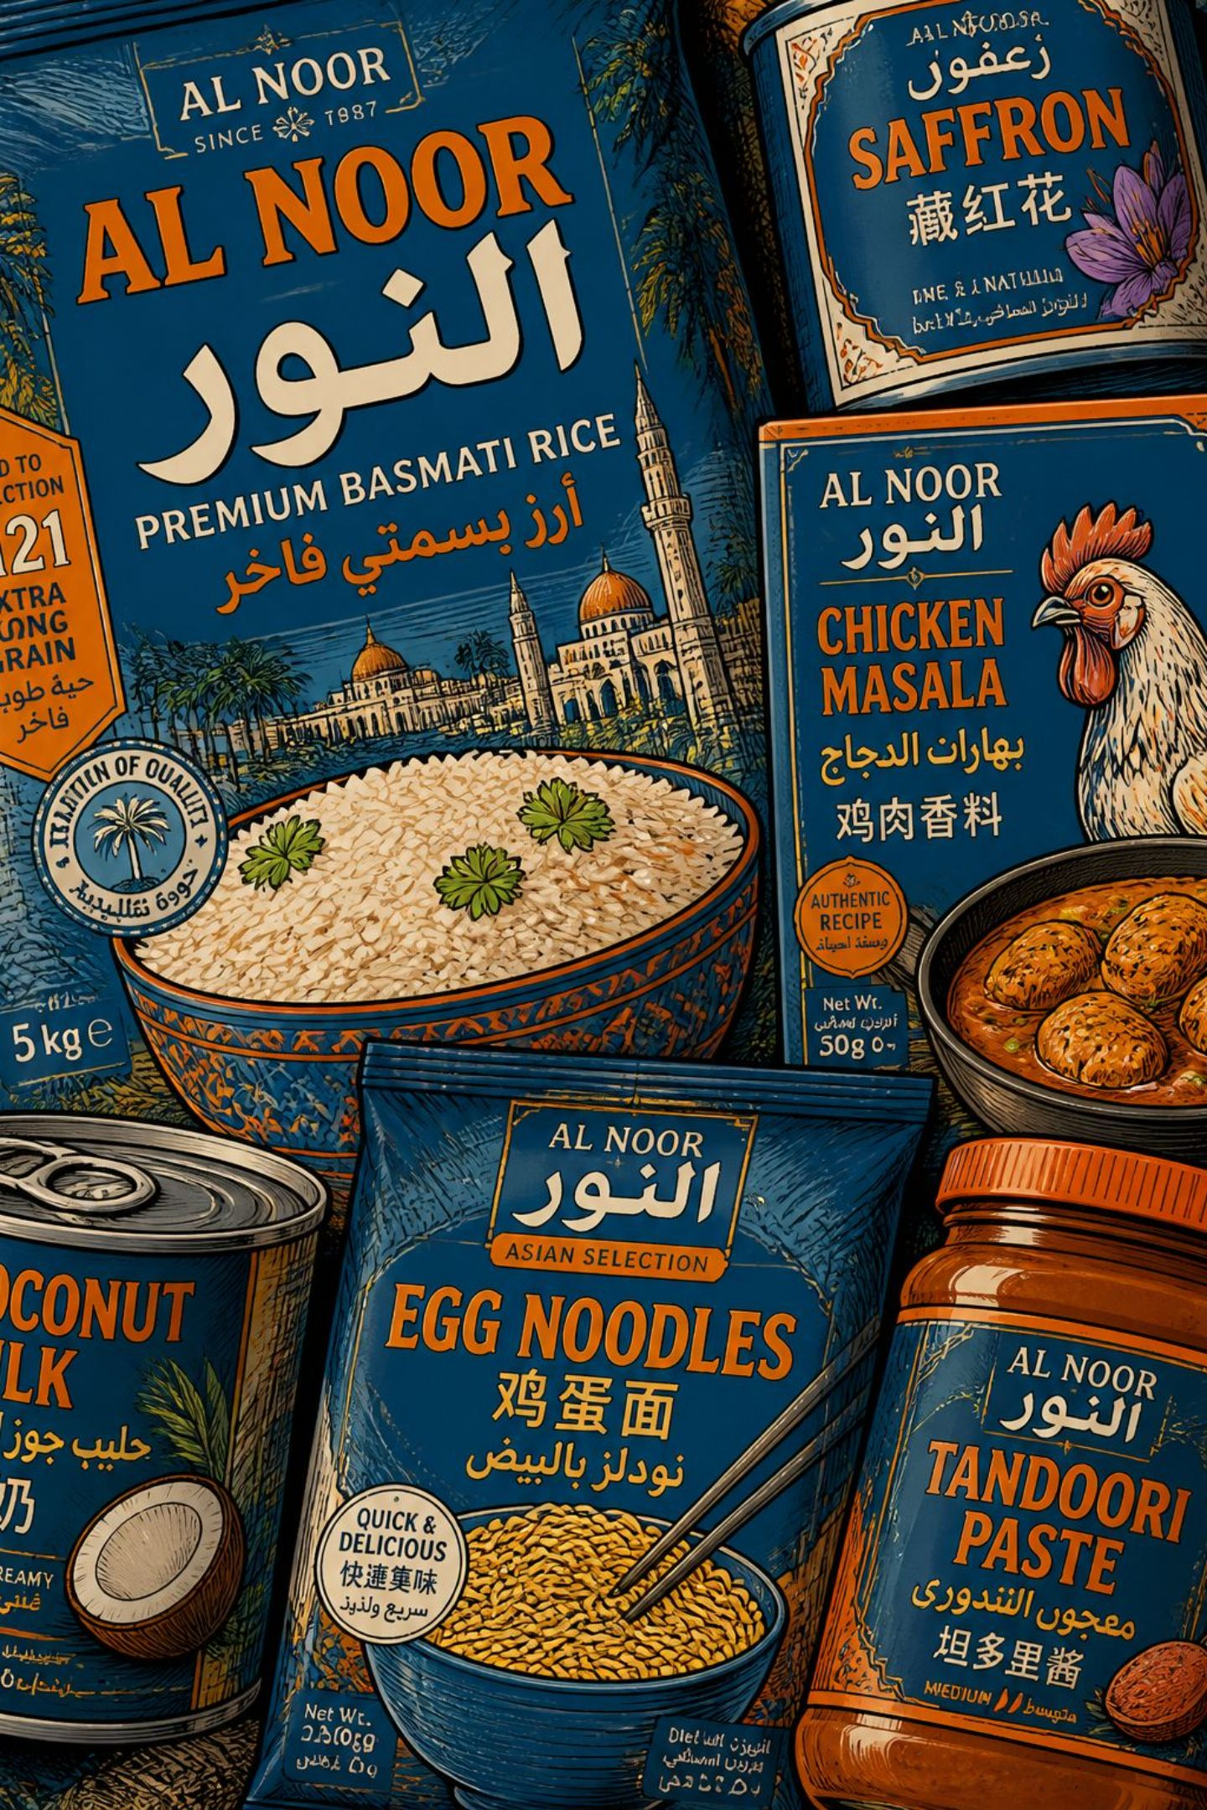



Background
Food labels vary by country, language, and industry vocabulary. Travelers and multilingual consumers often struggle to map ingredient names to allergens. Manual lookup is slow and error-prone; automation can increase speed and consistency.
Challenge
Language barriers, synonyms, and inconsistent ingredient nomenclature.
Opportunity
Combine OCR + NLP + translation to provide rapid, contextual allergen insights.
Safety note
Tool detects potential allergen matches; it does not provide medical guarantees.

Slide 4




Problem Statement
Many consumers cannot reliably determine whether a packaged food contains allergens when labels are in unfamiliar languages or use non-standard ingredient names. This increases risk, slows purchase decisions, and can lead to unsafe choices.
Core problem
Impact if solved
Inconsistent label language and terminology prevents quick allergen recognition.
Faster, clearer label understanding for consumers; potential reduction in accidental exposures and improved consumer confidence.

Slide 5

Aims & Objectives
1
Aim
Develop a mobile-capable system that identifies ingredients and flags potential allergens across languages.
2
Objective 1
Implement robust OCR that handles photos of labels and noisy backgrounds (complete within 4 months).
3
Objective 2
Create an NLP pipeline for ingredient normalization, NER (ingredient entities), and allergen mapping (complete within 8 months).
4
Objective 3
Integrate barcode lookup, multilingual translation, and a user allergy profile to provide personalized alerts (complete within 12 months).

Slide 6
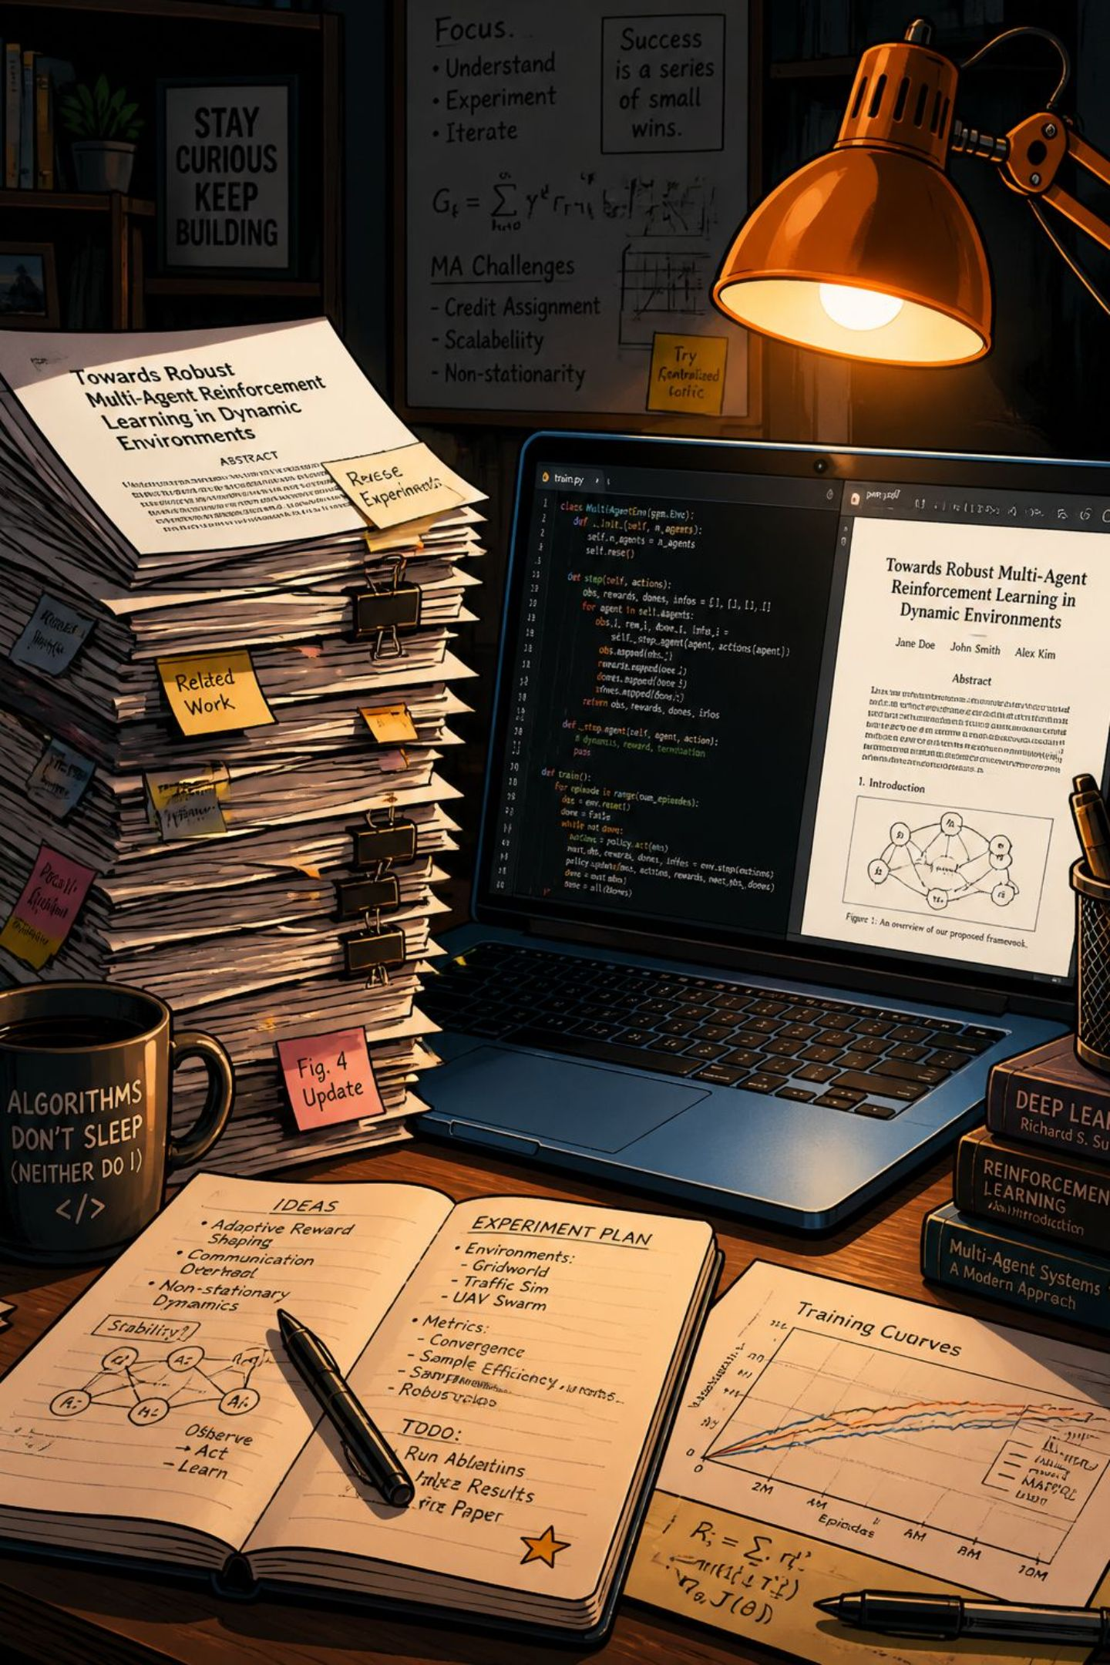
Literature Study
Existing solutions address OCR for labels, translation services, and allergen databases separately. Fewer tools integrate OCR→NLP→allergen mapping with personalized profiles. Key gaps: cross-language ingredient normalization, false positives from ambiguous ingredient names, and end-to-end user testing data.
Existing components
Identified gaps
OCR engines, machine translation, ingredient taxonomies, and allergen registries exist independently.
Integration, multilingual normalization, and transparent confidence scoring are under-explored.

Slide 7

Capture
OCR
Extract
Alert
The methodology follows a pipeline: capture → OCR & language detection → NLP extraction and mapping → personalized presentation with confidence scores and explanatory text. Methods include open-source OCR models, pretrained language models for NER, curated allergen lexicons, and lightweight mobile integration.

Slide 8
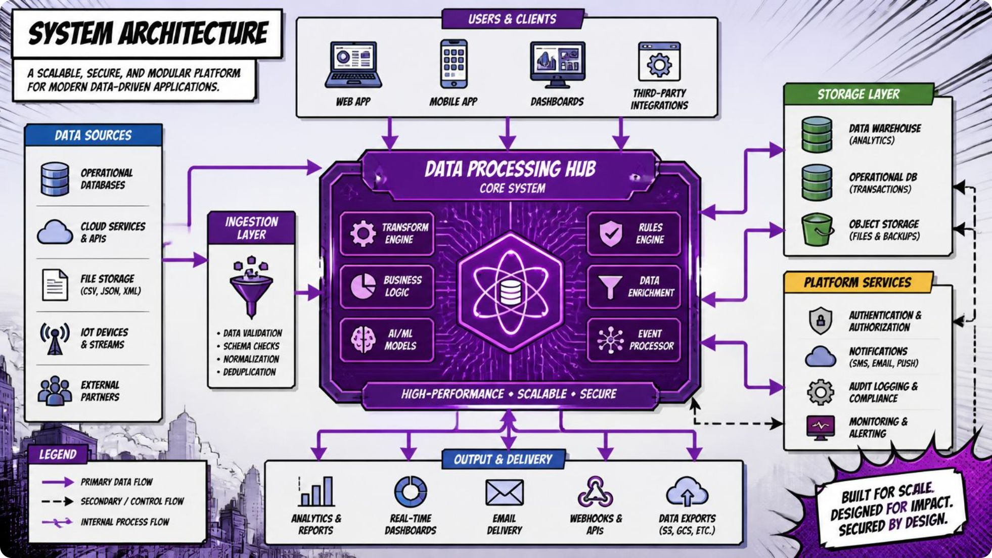
Proposed Design — Major Blocks
The solution is modular to support iterative development and testing:
Capture layer (camera, gallery, barcode)
OCR & image preprocessing
Language detection & translation
Ingredient extraction (NER) & normalization
Allergen matching & confidence scoring
User profile & personalization
Results UI with explanations and suggested next steps

Slide 9
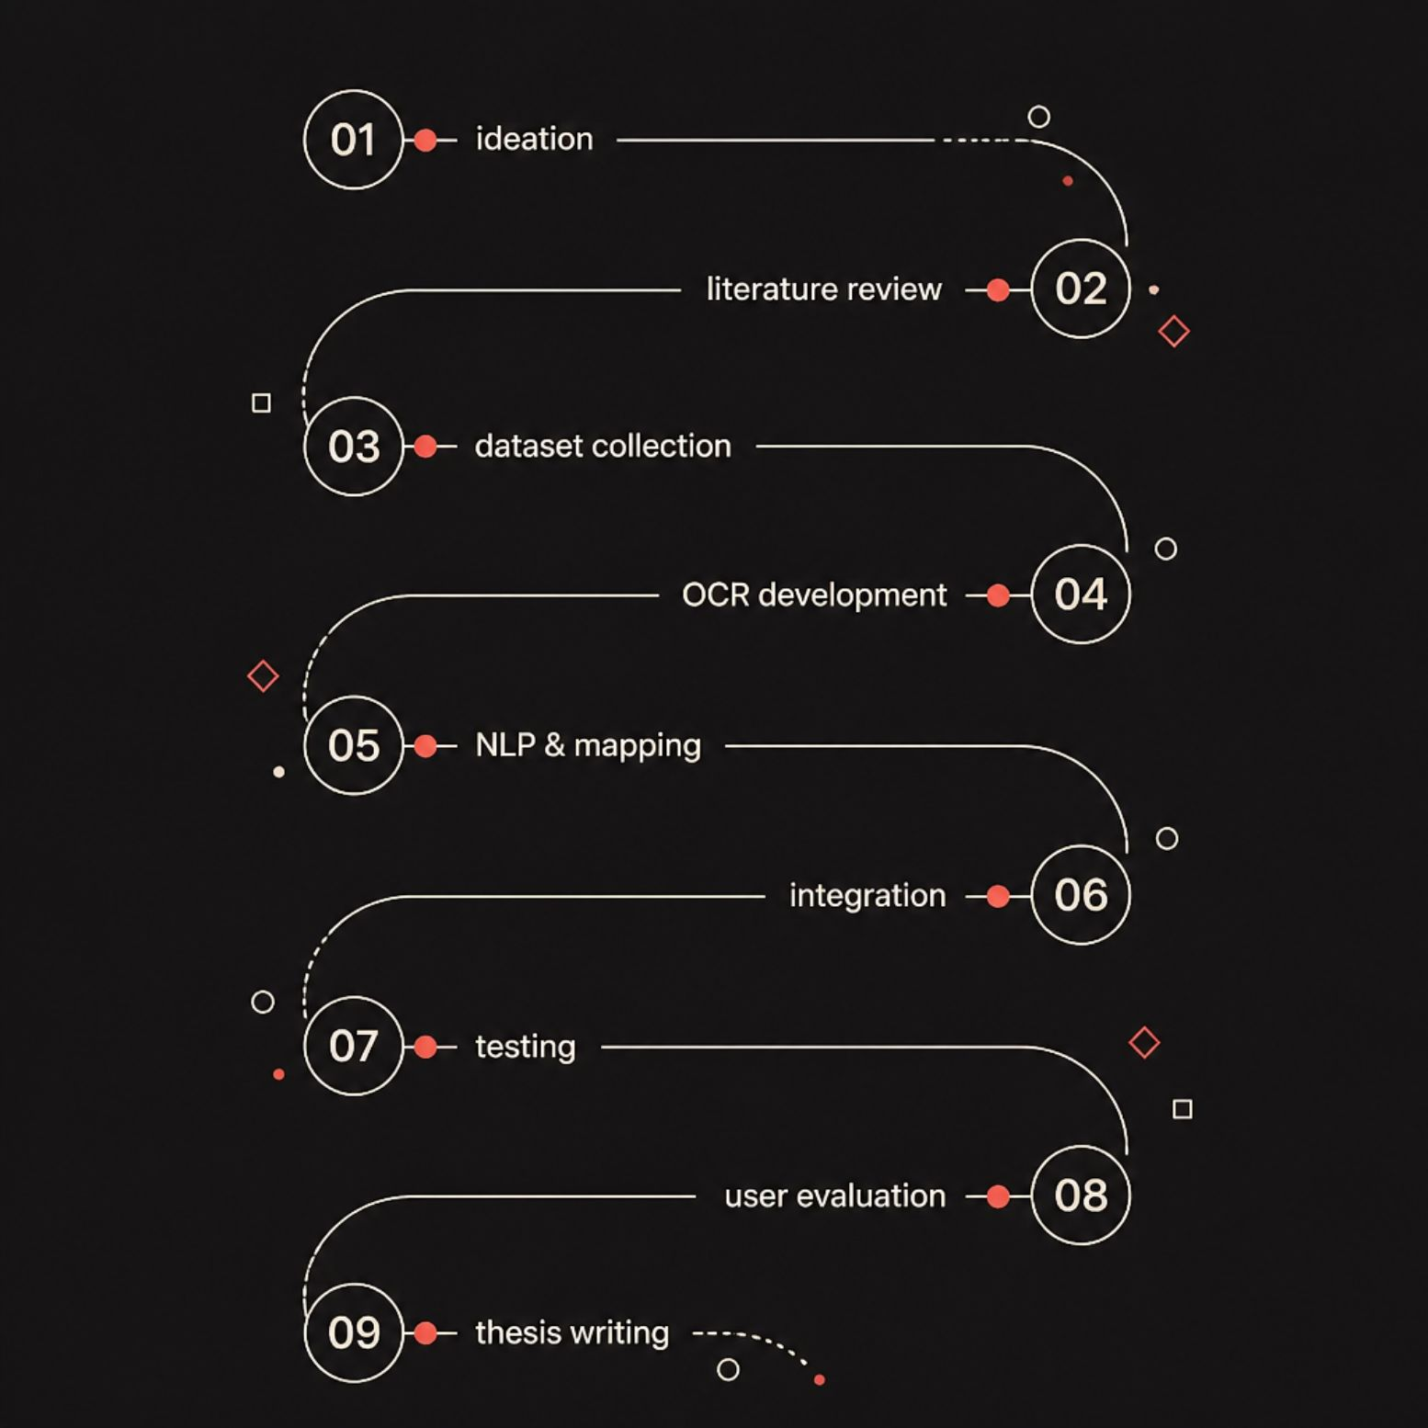
Project Timeline (12 months)
High-level monthly plan with milestones and deliverables. Examples below must be tailored to the specific project during planning.
Months 1–2: Ideation, requirements, dataset search
Months 3–4: OCR model selection & preprocessing pipeline
Months 5–7: NLP pipeline, ingredient normalization, allergen mapping
Months 8–9: Integration, barcode lookup, mobile UI prototype
Months 10–11: Testing, user studies, performance tuning
Month 12: Final results, thesis writing, submission

Slide 10

References
Per Superior University instructions, use IEEE citation style. The uploaded SafeLabel AI PPTX was not readable by the extractor, so verifiable bibliographic entries were not available. Insert project-specific IEEE references here when the source documents are accessible.
Reference (IEEE)
Notes
—
Reference list not recoverable from uploaded project files. Add full IEEE entries before submission.
Mandatory: Do not invent citations. Populate this table with IEEE-formatted references once full source PDFs or metadata are available.

